Slide 1
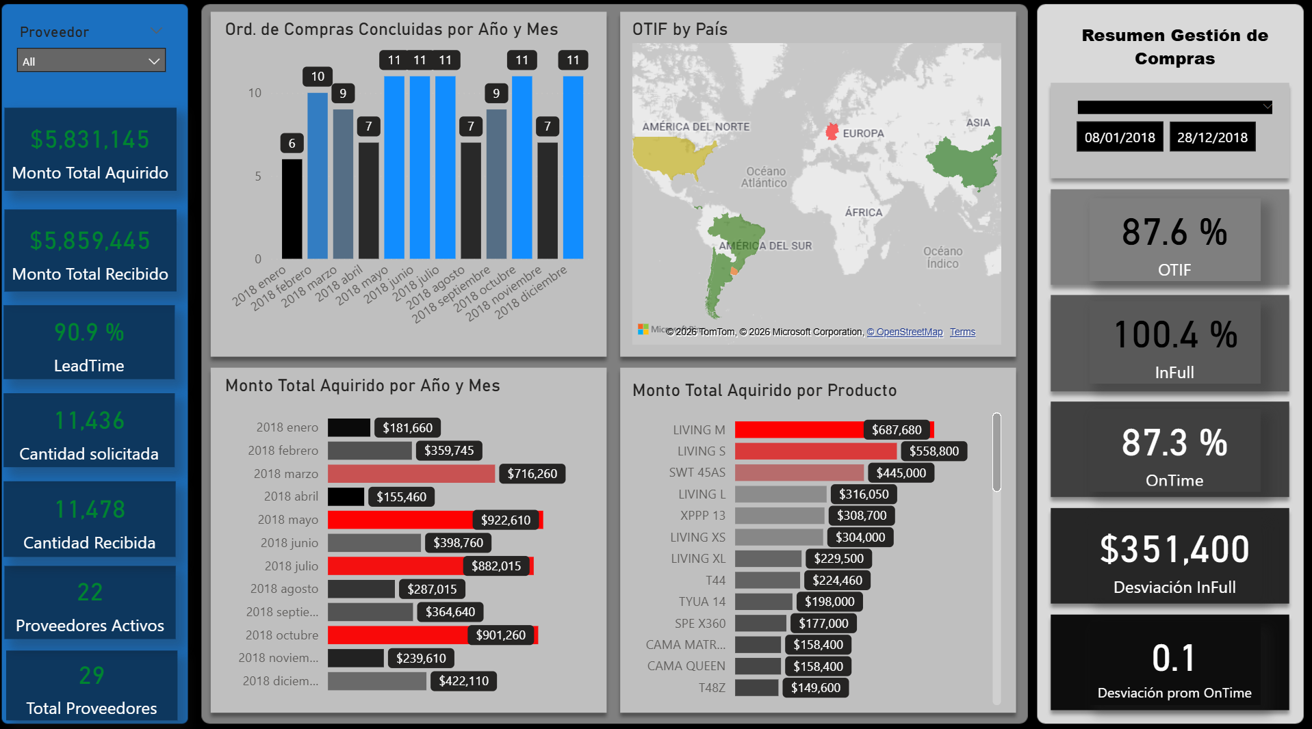
Purchasing Performance Dashboard
This dashboard monitors end-to-end purchasing performance by tracking purchase orders, acquired vs. received amounts, supplier activity, and OTIF (On Time In Full) metrics by time period, product, and country. It enables procurement teams to identify delivery reliability issues, spending concentration, and supplier performance trends to improve service levels and supply chain efficiency.

Slide 2
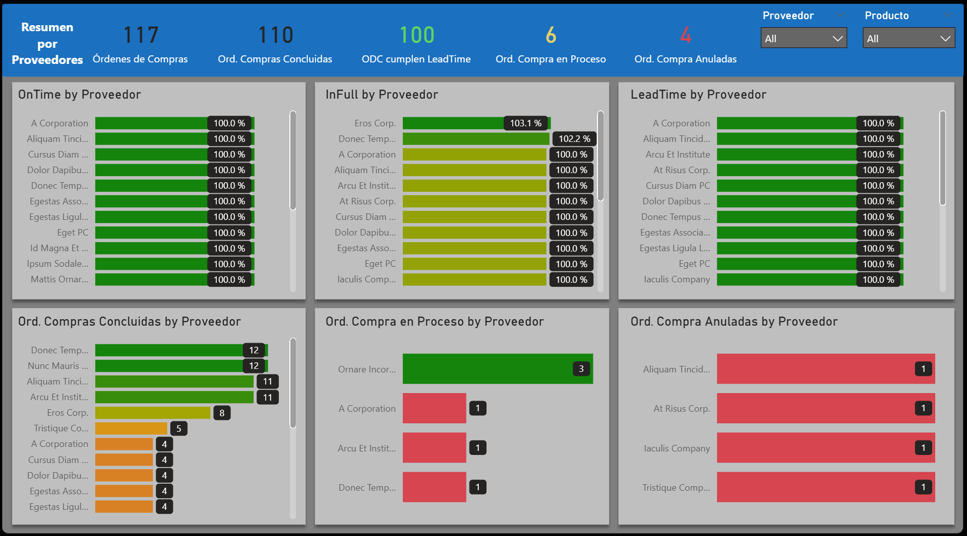
Supplier Performance Detail
This view breaks down purchasing performance by supplier, showing OnTime, InFull, and Lead Time compliance, along with completed, in-process, and cancelled purchase orders. It enables quick identification of high- and low-performing suppliers to support procurement decisions and supplier management.

Slide 3
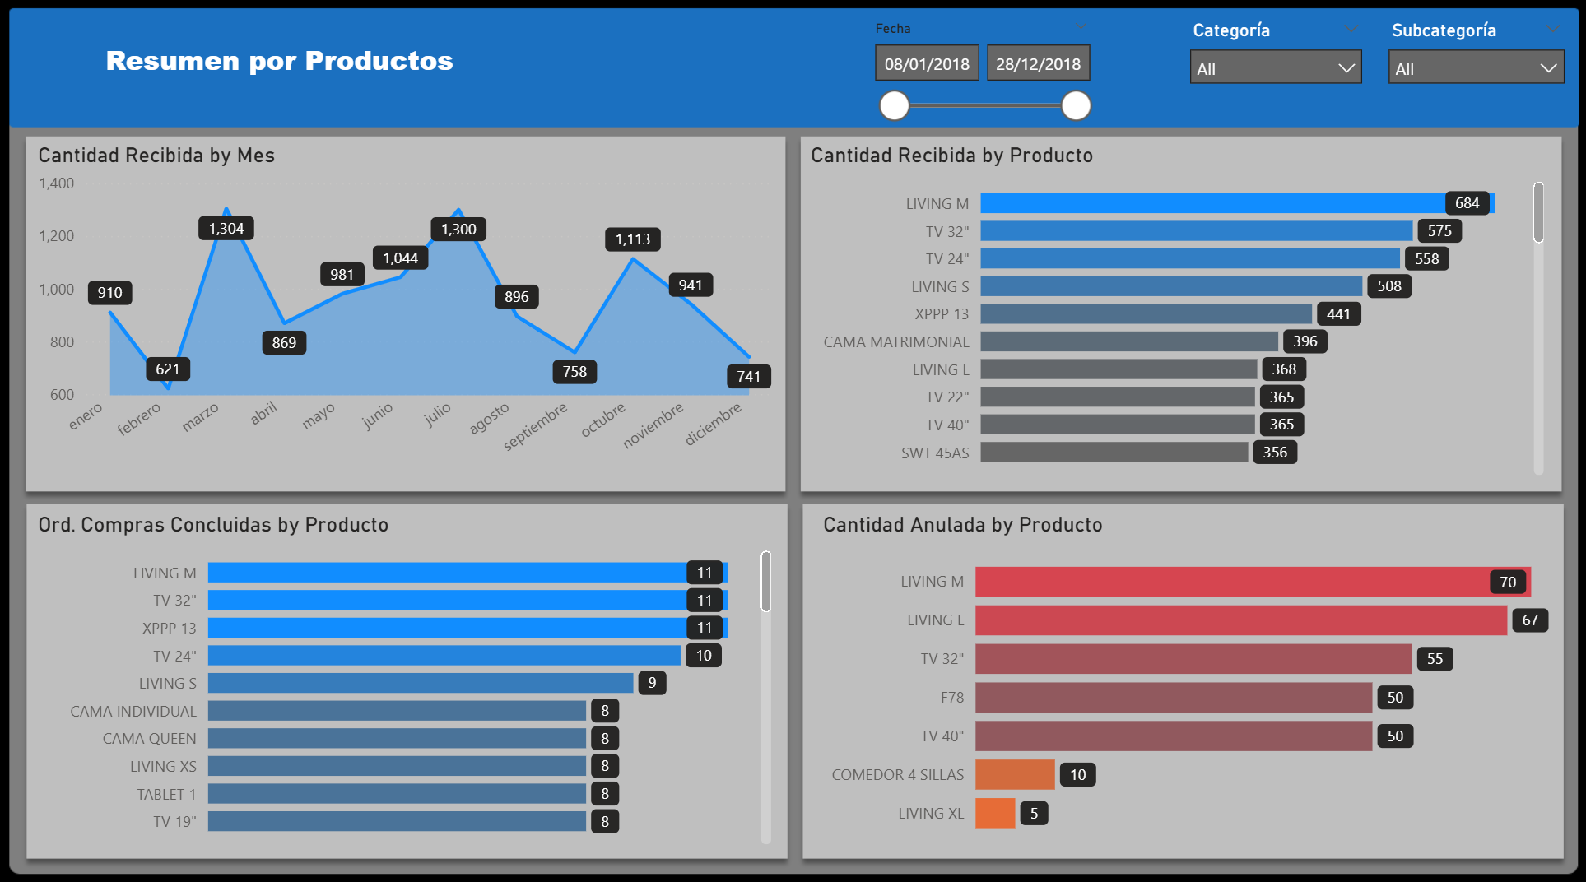
Product-Level Purchasing Summary
This view analyzes purchasing performance at the product level, showing received quantities over time, completed purchase orders, and cancelled quantities by product. It helps identify high-volume products, demand patterns, and items with elevated cancellation risk to support inventory and procurement decisions.

Slide 4
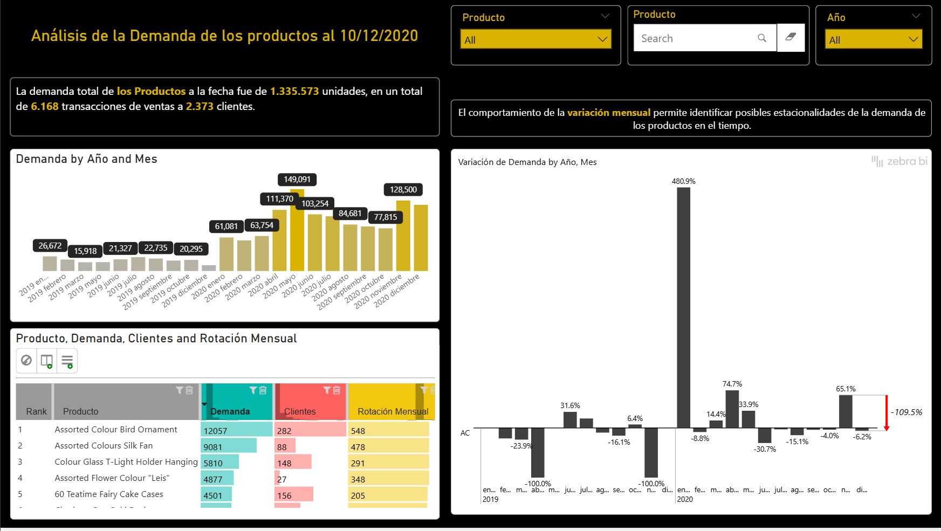
Demand Analysis with Automated Storytelling
This dashboard analyzes product demand over time, highlighting total demand, customer activity, and monthly demand variation with automated narrative insights. It helps identify seasonality, demand trends, and high-rotation products to support forecasting and inventory planning.

Slide 5
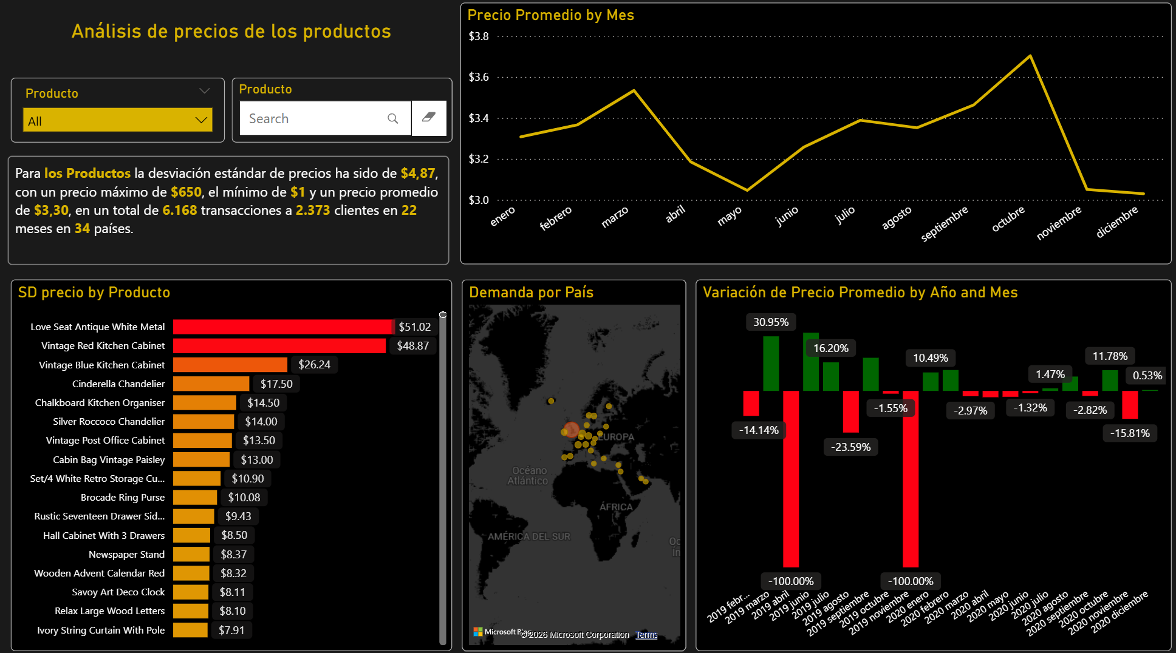
Product Pricing Analysis
This dashboard analyzes product pricing behavior over time, showing average price trends, price volatility by product, and price variation by month and year across markets. It supports pricing strategy decisions by identifying unstable prices, seasonal effects, and products with high price dispersion.

Slide 6
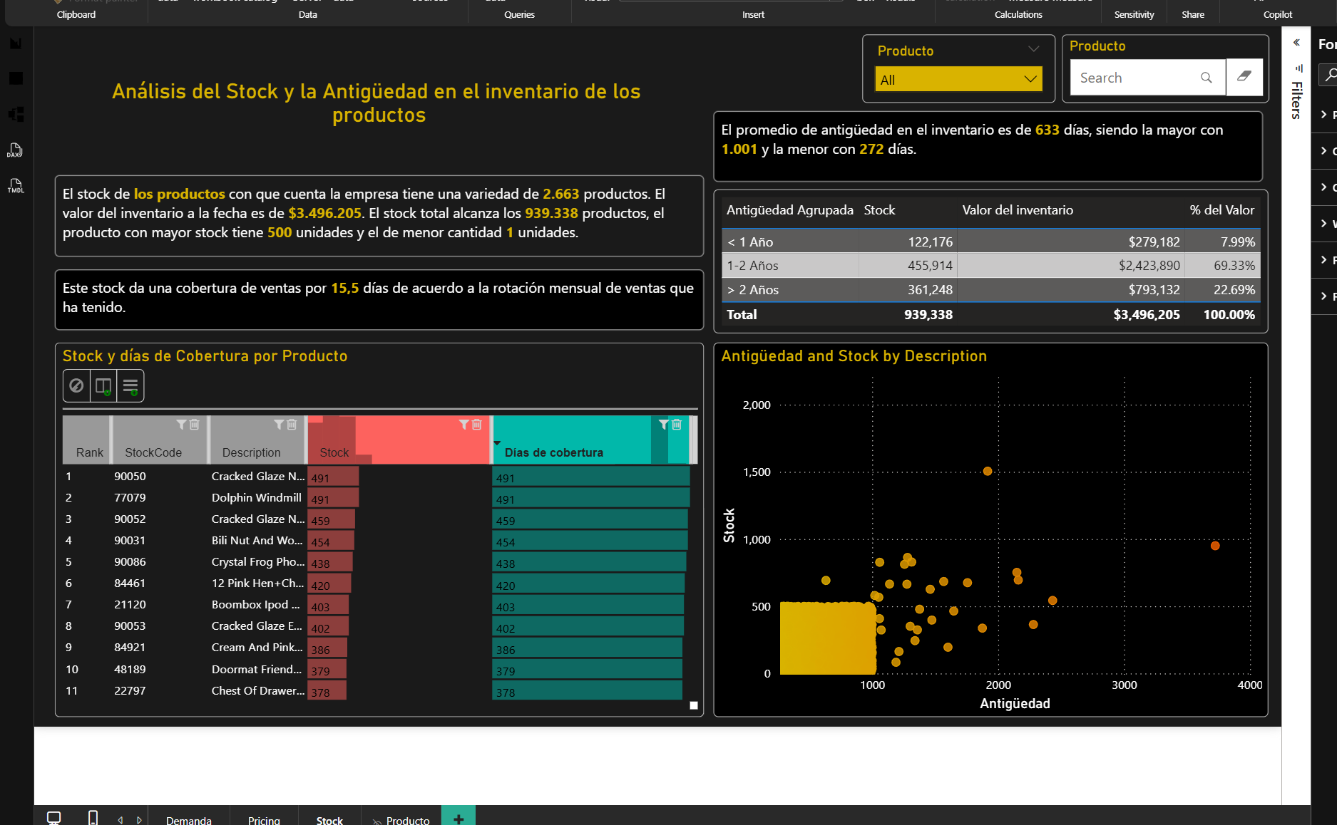
Inventory Stock and Aging Analysis
This dashboard evaluates inventory levels and aging, showing stock quantity, inventory value, days of coverage, and product aging distribution. It helps identify slow-moving or overstocked items and supports inventory optimization and working capital decisions.

Slide 7
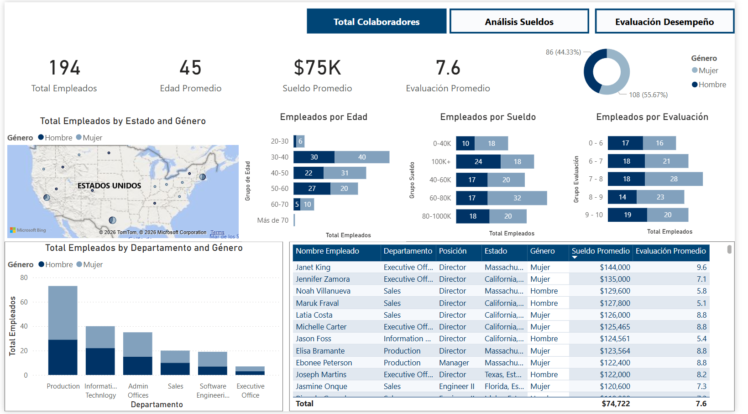
HR Workforce Overview
This dashboard provides a comprehensive view of the workforce, showing headcount, average age, salary, and performance, with breakdowns by gender, location, department, and role. It supports HR decisions related to compensation analysis, talent distribution, and performance management.

Slide 8
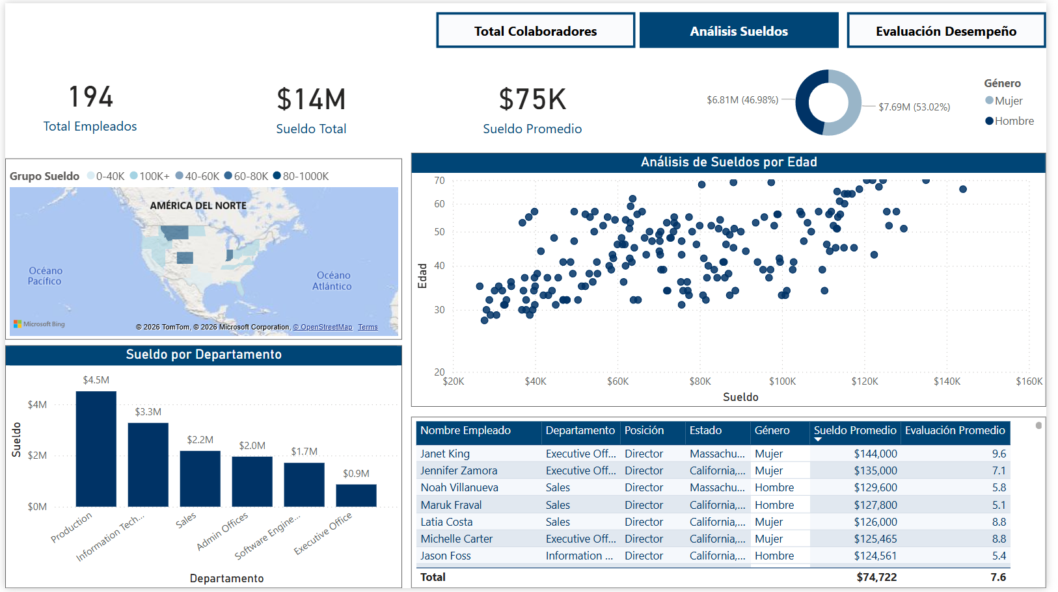
Salary Analysis Dashboard
This dashboard analyzes employee compensation, showing total and average salaries, salary distribution by age, department, location, and gender. It supports compensation benchmarking, pay equity analysis, and workforce cost management.

Slide 9
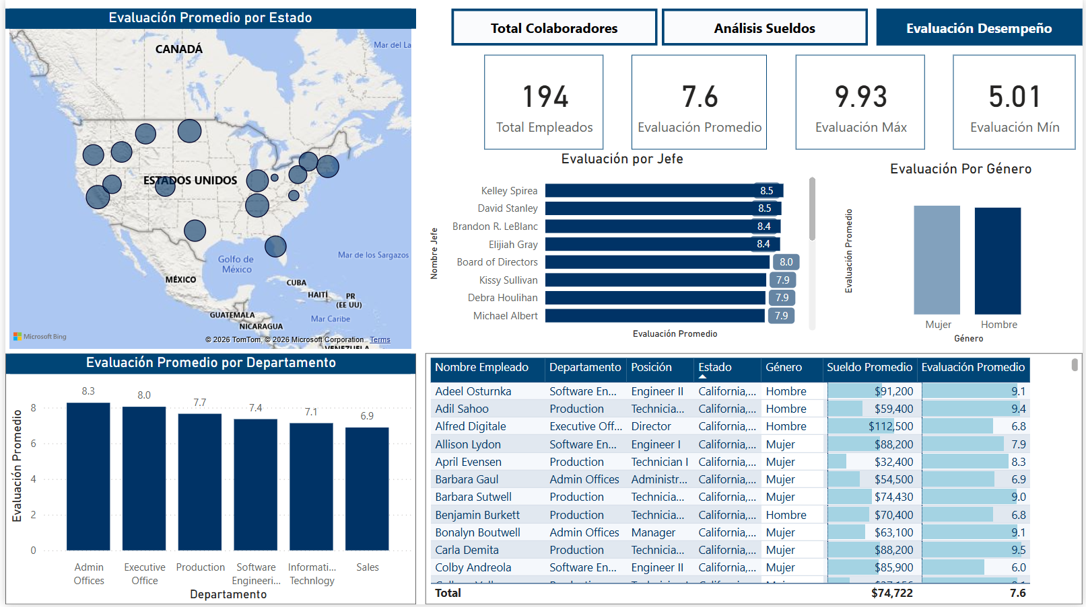
Employee Performance Evaluation Dashboard
This dashboard analyzes employee performance ratings, showing average, minimum, and maximum scores with breakdowns by location, department, manager, and gender. It supports performance management, leadership assessment, and identification of high- and low-performing teams.

